Slide 1
Course work for t-test

Slide 2
Exercise 1: We are interested in the relationship between oral contraceptive (OC) use and blood pressure in women. Ten nonpregnant, premenopausal women of childbearing age (16–49 years) were enrolled. Their SBP were measured before and after they were prescribed OC for 1 year. Assess the statistical significance of the OC–blood pressure data in Table.
Id | Before | After
1 | 115 | 128
2 | 112 | 115
3 | 107 | 106
4 | 119 | 128
5 | 115 | 122
6 | 138 | 145
7 | 126 | 132
8 | 105 | 109
9 | 104 | 102
10 | 115 | 117

Slide 3
Exercise 2: Suppose a sample of eight 35- to 39-year-old nonprenant, premenopausal OC users who work in a company and have a mean systolic blood pressure (SBP) of 132.86 mm Hg and sample standard deviation of 15.34 mm Hg are identified. A sample of 21 nonpregnant, premenopausal, non-OC users in the same age group are similarly identified who have mean SBP of 127.44 mm Hg and sample standard deviation of 18.23 mm Hg. What can be said about the underlying mean difference in blood pressure between the two groups?
Meanwhile, compute a 95% CI for the true mean difference in systolic blood pressure (SBP) between 35- to 39-year-old OC users and non-OC users.

Slide 4
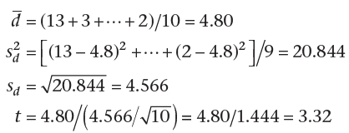
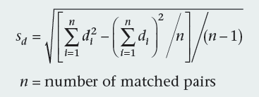
Answer1: paired ttest
Id | Before | After | d=before-after | d-square
1 | 115 | 128 | -13 | 169
2 | 112 | 115 | -3 | 9
3 | 107 | 106 | 1 | 1
4 | 119 | 128 | -9 | 81
5 | 115 | 122 | -7 | 49
6 | 138 | 145 | -7 | 49
7 | 126 | 132 | -6 | 36
8 | 105 | 109 | -4 | 16
9 | 104 | 102 | 2 | 4
10 | 115 | 117 | -2 | 4
sum |  |  | -4.8 | 418
average |  |  | -4.8
t0_{.05/2,0.05} = 2.262
Reject

Slide 5


Answer2: independent ttest
The sample standard deviation of blood pressure for the 8 OC users was 15.34 and for the 21 non-OC users was 18.23. Hence the variance ratio is
the underlying variances of the two samples do not significantly differ from each other.

Slide 6
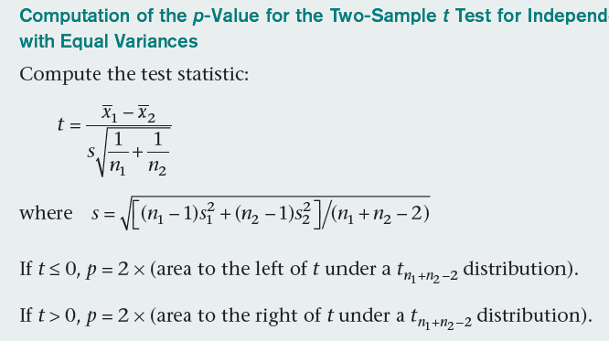
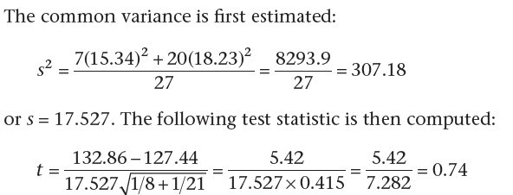
t27,.975 = 2.052.
Accept

Slide 7
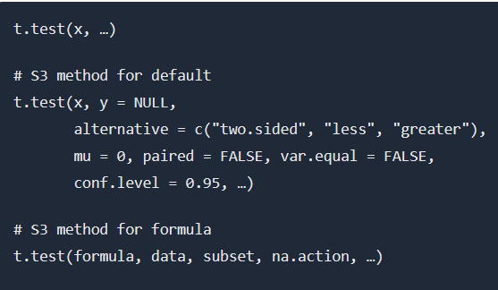
t.test: Student's t-Test
Performs one and two sample t-tests on vectors of data.
X=data
Y=group
Notes:
Arguments
x
a (non-empty) numeric vector of data values.
y
an optional (non-empty) numeric vector of data values.
alternative
a character string specifying the alternative hypothesis, must be one of "two.sided" (default), "greater" or "less". You can specify just the initial letter.
mu
a number indicating the true value of the mean (or difference in means if you are performing a two sample test).
paired
a logical indicating whether you want a paired t-test.
var.equal
a logical variable indicating whether to treat the two variances as being equal. If TRUE then the pooled variance is used to estimate the variance otherwise the Welch (or Satterthwaite) approximation to the degrees of freedom is used.
conf.level
confidence level of the interval.
formula
a formula of the form lhs ~ rhs where lhs is a numeric variable giving the data values and rhs a factor with two levels giving the corresponding groups.
data
an optional matrix or data frame (or similar: see model.frame) containing the variables in the formula formula. By default the variables are taken from environment(formula).
subset
an optional vector specifying a subset of observations to be used.
na.action
a function which indicates what should happen when the data contain NAs. Defaults to getOption("na.action").
…
further arguments to be passed to or from methods.

